Slide 1
VFD Application Remedies
dV/dT Filters
Input/Output Reactors
Harmonic Filters
SineWave Filters
RFI/EMI Filters
NONE OF THE ABOVE EQUIPMENT MEDIGATE
BEARING FLUTING

Slide 2
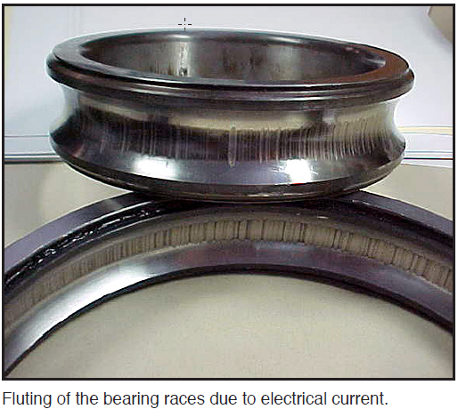
FLUTING

Slide 3
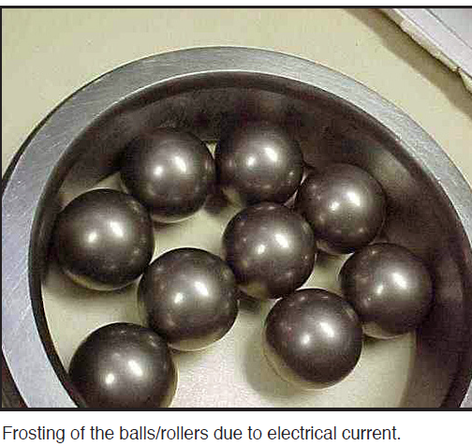
FROSTING

Slide 4
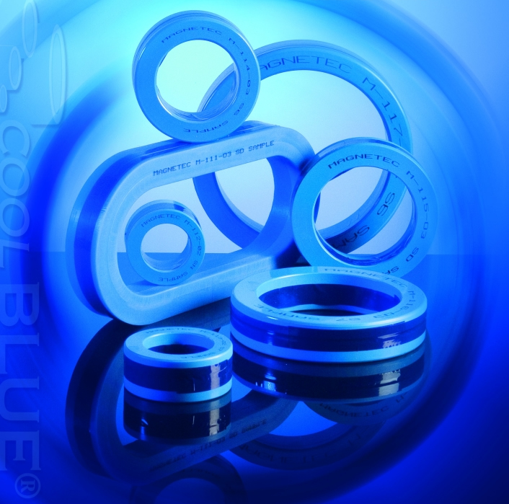
CoolBLUE® Inductive Absorbers
NaLA® Noise Line Absorbers
Motor Bearing Solution from
MH&W International Corp.
http://www.coolblue-mhw.com
coolblue@mhw-intl.com

Slide 5
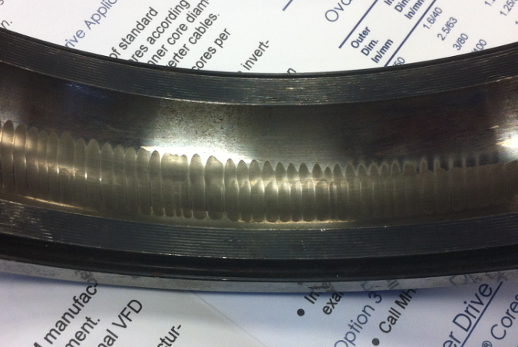
Electrical Discharge Machining
AC Motor Drive systems utilizing variable frequency controls produce high frequency electrical noise. The noise is superimposed on the power drive lines of the motors in the form of common mode noise. The common mode noise creates a voltage (dv/dt) across the rotor/stator of the motor resulting in a discharge current through the lubrication and motor bearings to the motor raceway.
This current discharge produces an EDM effect (Electrical Discharge Machining) that causes destructive pitting and damage to the motor raceway, and premature lubrication breakdown. The end result is premature failure of the motor causing expensive repairs and system downtime.
Example: Outer Bearing Race Fluting EDM
Results from VFD Induced Common Mode Noise

Slide 6
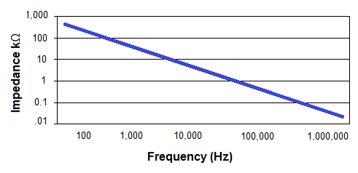
Example of High Frequency Noise
As the frequency of the common mode noise increases, the impedance of the system goes down. This graph shows how low the impedance goes as the frequency increases from Hz to MHz. The decrease in the impedance allows more and more current to flow.

Slide 7
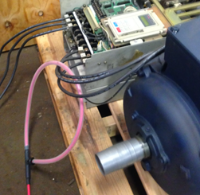
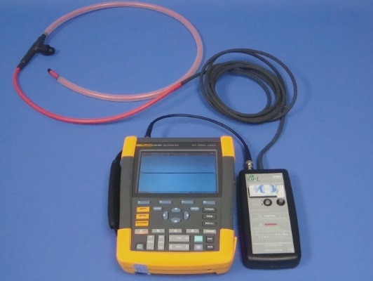
Determining the Problem
MH&W suggests using a flexible, clip-around current probe to measure high frequency destructive common mode currents in motor drives . . . high frequencies produced by motor drive IGBT’s in the kHz up to several MHz’s.
The high frequency Rogowski coil simply attaches around the 3 power phases of cable going from the drive to the motor. The output of the Rogowski coil connects to any oscilloscope (suggested 40MHz and above), and measures the common mode current.
Very minimal downtime is needed in order to measure current. Simply power down, place the red Rogowski coil around 3 phases of power. Power up system. Measure current.

Slide 8
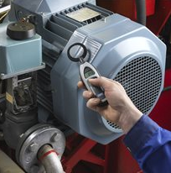
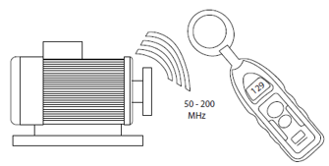
Determining the Problem
The electrical discharge in a motor bearing is a charge-discharge similar to a spark. A large current is flowing from a high potential to ground. This spark, or arc, generates a high frequency noise that can be detected. A test instrument with antennae can sense every time the spark is generated.
One such piece of test equipment is the SKF EDD test equipment, model TKED 1. Holding the TKED 1 close to the motor where the motor bearings are located, the equipment measures every discharge.
This is a safe method of identifying potential problems in that there is no contact with the motor.

Slide 9
Determining the Problem
Shaft Grounding
There are methods of testing the voltage discharge from shaft to ground by use of brush or wire attached to an oscilloscope probe.
While this may be effective for measuring voltage, it creates several issues:
Method of testing with brush probe is dangerous, and sometimes not accessible, especially in vertical mount motors. A large number of corporations forbid this type of field testing due to safety concerns.
The shaft has to be cleaned and prepped in order to make a good contact.
Not all systems in the field are accessible.
Downtime of system – obtaining access to shaft, preparation of shaft, installing probe, powering system up, powering system down, and disconnecting probe.
While voltage is part of the formula for system failures, watts are the destructive force (V * I = Watts). For example, 30 volts times 1 amp is 30 Watts of power. 30 volts times .1 amp is only 3 watts. Again, measuring current with a Rogowski coil is the only method for accurately measuring the destructive force in a system.

Slide 10
Solutions
There are three solutions that are commonly employed to solve or correct the effects of power line noise on VFD motor systems:
Shaft Grounding Device
Insulated Bearings
Inductive Absorption Device

Slide 11
Shaft Grounding Devices
This is a mechanical solution whereas devices have a brush or fiber, usually copper or other high conductivity metal, that rides on the motor shaft. Current does not go through the bearing but is instead conducted directly to ground (via motor casing) through the brush. These brushes are especially selected to tolerate misalignment and maintain rotating contact throughout the brush's life when properly maintained. The problems with this solution are:
Brushes must be properly maintained/replaced–system becomes expensive over time.
Brushes lose contact with the shaft over time due to heat, contaminants, and physical wear.
Must be replaced periodically causing downtime for maintenance.
This solution only protects the motor bearings. A significant problem in the field is with stray capacitive currents flowing in the system. Shaft grounding just adds to this problem.
100HP and above must have isolated/hybrid bearing on opposite end to force current through brush. Added cost and maintenance time.
Method of testing with brush probe is dangerous, and sometimes not accessible.
Literally hundreds of choices of solutions. i.e. epoxy, drill and tap, shaft size varies per hp/ kilowatts, wash down applications, chemical/harsh environment resistant, hazardous conditions safety, poor grounding of motor casing.

Slide 12
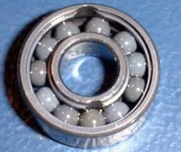
Insulated Bearings
This is a mechanical solution where the motor bearings are made of an insulated material or insulated coating. This system is effective at avoiding damage to the bearings and the resulting downtime of the motor system. The problems associated with this solution are:
Very expensive
Motor bearings do have to be replaced, increasing the expense over time
This solution only protects the motor bearings

Slide 13
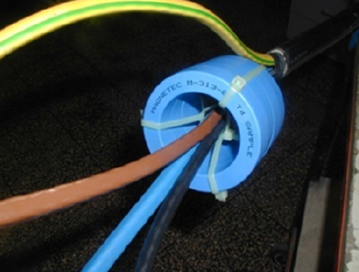
Inductive Absorption Device
Common Mode Choke
Inductive absorption is an electrical solution whereas inductive components are placed over the drive cables to absorb the transient voltage and common mode currents. The inductive components need to have high permeability, high saturation, and low power loss. They do not affect the symmetrical power currents but efficiently dampen the asymmetrical EMI noise currents. This creates a common mode choke.
The initial installation cost is about the same, or less, as other solutions. The long term costs are negligible as there is no maintenance, or replacement ever needed with this solution.

Slide 14
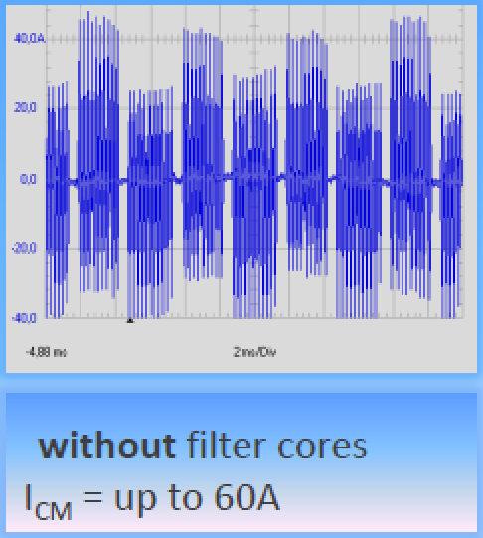
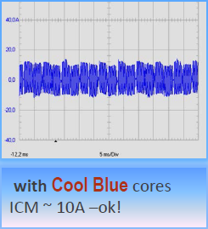
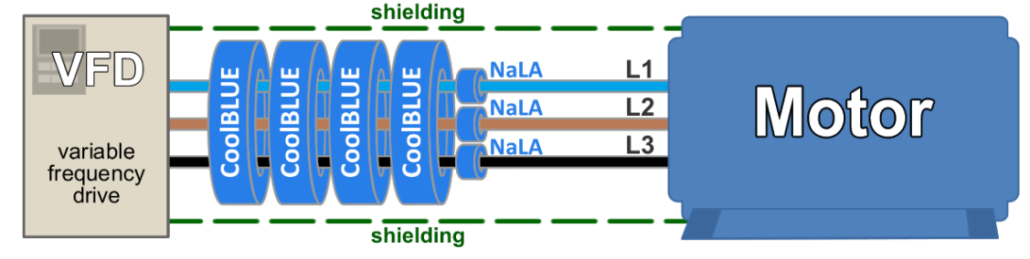
The Inductive Absorber -
Common Mode Choke Solution
The advantages of the Inductive Absorber/Common Mode Choke solution are:
Installation cost same, or less, as other solutions
Very easy to install around power cables
Reduces line noise by a factor of 4:1 or better
Can be retrofitted with little or no problem
Reduces transient voltages, stray capacitive currents, and common mode currents before they reach the motor system
Small number of cores fit all motor applications
Electronic devices like sensors are protected as well as motor bearings
Lifelong solution – magnetic properties do not degrade over time nor affected by heat

Slide 15
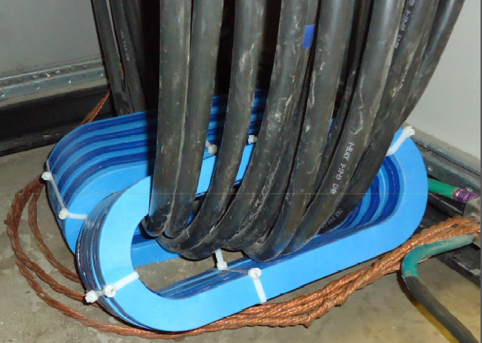
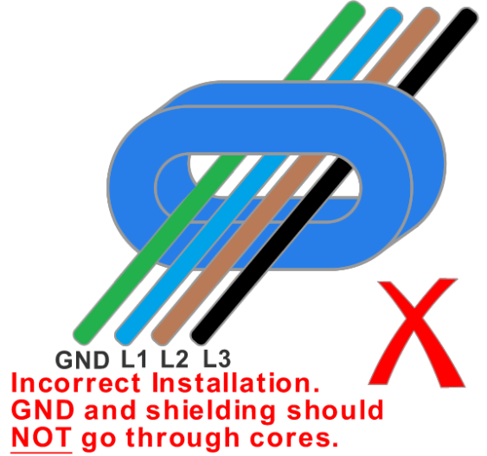
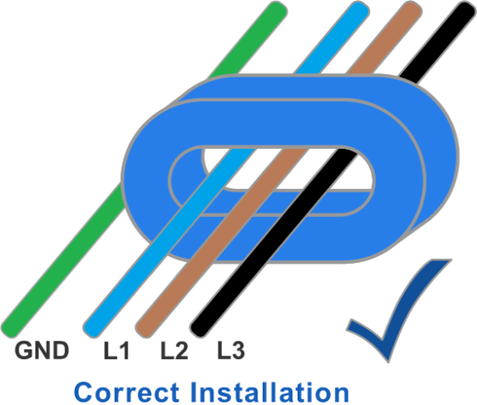
Correct Installation of CoolBLUE Cores
3 power phases must go through cores as shown below.
No grounding wire or shielding.
In the case of multiple conductors, all power conductors go through cores. Again, not ground or shielding.
Multiconductor Example

Slide 16
NaLA®
Nanoperm Line Absorber
Servo–Motors and High Reliability DC to 100 MHz
NaLA Inductive Absorbers increase the reliability of the system by further reducing noise and peak values.
In applications up to 10HP, or where high reliability is needed, the use of NaLA differential mode line absorbtion is necessary. The use of NaLA increases the reliability of these systems by further reducing the noise and peak values of current. These cores must be placed around each individual wire. Not around all phases like CoolBLUE. NaLA is to be used in conjunction with CoolBLUE common mode choke cores.

Slide 17
How Many Cores are Needed per Application
Determine the motor size by either horsepower, or kilowatts
Determine the cable length
Reference “VFD Application Guide CoolBLUE cores per power range and cable length”
Choose either round or oval. The round and oval in each column are exactly the same electrically. Oval shaped is sometimes easier to feed the cables through
VFD Application Guide CoolBLUE® Cores per power range and cable length
CoolBLUE® Round | M-367 | M-367 | M-113 | M-116 | M-117 | Round Ver. N/A
CoolBLUE® Oval | M-049 | M-049 | M-283 | M-302 | M-111 | M-248
Power Range (hp) | *1/4-10 (Use with NaLA®) | 11-50 (Use with NaLA®) | 51-100 | 101-428 | 429-1632 | 1632+
Cable Length | # Cores | # Cores | # Cores | # Cores | # Cores | # Cores
150ft/50m | 2 | 4 | 4 | 4 | 4 | 4
300ft/100m | 2 | 4 | 4 | 4 | 4 | 4
450ft/150m | 2 | 4 | 6 | 6 | 6 | 6
900ft/300m | 4 | 8 | 8 | 8 | 8 | 8

Slide 18
Important Notes about CoolBLUE Installation
Note 1 – CoolBLUE normal operation is below 158°F/70°C. It is important to use the correct number of cores to avoid saturation.
Note 2 – On motors up to 10HP, two turns are needed through the cores (pass cable through cores twice).
Note 3 – Data in the application guide is for information and guideline purposes. Please contact MH&W Engineering for detailed information.
Note 4 – Round and oval shaped cores are for ease of installation and mechanical functionality. Round and oval cores have same basic electrical absorption.
Note 5 – Cores must be installed on the load side of the drive only. If possible, installing cores in a drive cabinet is preferred.
Note 6 – Do not place conductive wires through the cores for holding cores in place. MH&W offers brackets, and cable ties to hold cores in place.

Slide 19
NaLA®
VFD Differential Mode Noise Line Absorbers
How Many Cores are Needed per Application
Determine the motor size by either horsepower, or kilowatts
Determine the cable length
Reference “VFD Application Guide NaLA cores per power range and cable length”
Use in conjunction with appropriate CoolBLUE cores.
VFD Application Guide NaLA® Cores per power range and cable length
NaLA® Part number | M-053 | M-102 | M-381 | M-613 | M-614 | M-616
Power Range (hp) | 1/4-10 | 11-40 | 41-102 | 103-428 | 429-1631 | over 1631
Cable Length | # Cores | # Cores | # Cores | # Cores | # Cores | # Cores
150ft/50m | 2 | 1 | 1 | 1 | 1 | 1
300ft/100m | 3 | 2 | 2 | 2 | 2 | 2
450ft/150m | 4 | 3 | 3 | 3 | 3 | 3
900ft/300m | 5 | 4 | 4 | 4 | 4 | 4

Slide 20
Important Notes About NaLA® Installation
Note 1 – NaLA normal operation is below 158°F/70°C. It is important to use the correct number of cores to avoid the cores getting hot.
Note 2 – NaLA cores must go around each individual power cable. Not around all like CoolBLUE.
Note 3 – Data in the application guide is for information and guideline purposes. Please contact MH&W Engineering for detailed information, if needed.
Note 4– Cores must be installed on the load side of the drive only.
Note 5 – Do not place conductive wires through the cores for holding cores in place. This effectively bypasses the inductive properties of the cores. MH&W offers brackets, and cable ties to hold cores in place.

Slide 21
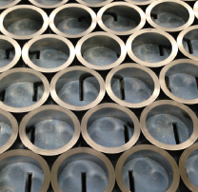
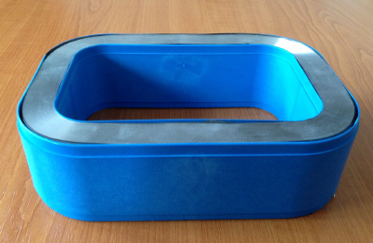
CoolBLUE® and NaLA® Packaging
CoolBLUE and NaLA are made up of a Nanocrystalline tape, wound many times. The tape, after processing, is placed inside a premade plastic case.
The plastic case provides better performance (no pressure on the core).
Handling is much more robust and does not break if dropped.
Cost is lower than any other type of performance coating.

Slide 22
Industry Application Example #1
Example: Industrial paper plant manufacturer with typical 150hp IGBT/motor system…350 AWG per phase cabling.
Problem - Customer experiencing random shut downs of system, and premature bearing failures on 150HP motor system. Bearing fluting was evident, and need of repair, every 8 weeks.
Successful Solution - 4 each M-116 cores were placed around cabling. Current reduction of over 75% was seen, which resulted in multiple years of no bearing fluting/frosting/etc. failures. Equally important was no more random system shutdowns because of high frequency stray grounding currents.

Slide 23
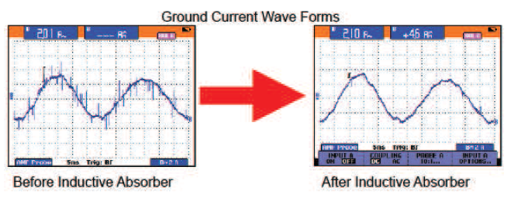
Industry Application Example #1
(continued)
Example:
Paper plant with typical 150hp VFD motor system. The motor cables were shielded and about 100 feet. Current measurements were taken before and after the addition of the Nanocrystalline cores.
Four Nanocrystalline cores were placed over the three leads at the output of the inverter inside the shielding. Significant reduction in the noise level of ground current are shown. Both power ground and signal ground share the same common ground. When noise levels on the ground current are high enough, the noise is injected into signal circuits inductively coupled to the common ground.
The ground loop current caused by the noise also generates a radio frequency noise that again affects surrounding equipment primarily on the signal lines. CoolBLUE cores absorbed this high frequency noise current, and no more random shutdowns were experienced within the plant on the system.

Slide 24
Industry Application Example #2
Problem – Large chiller manufacturer was experiencing bearing failures within two to four years. Manufacturer opted to use ceramic coated bearings on new builds, and customer repair replacements. Cost was very high to build and replace. Also, customers reported still having failures in short time span.
Successful Solution – All new systems at factory, and in field rebuilds of ceramic coated bearings systems, are now built with 5 each M-116 cores placed around cabling. Reduction of over 85% was seen in current. End results… 6+ years of no bearing fluting/frosting/etc. Failures with standard steel bearings

Slide 25
Industry Application Example #3
Problem – Automotive manufacturer experiencing random shut down of system, multiple system errors, and other manufacturing failures with Ethernet controlled 600 HP system. High frequency stray grounding currents evident in system ground because of poor building ground. Premature failure of bearings due to large common mode currents.
Solution – 4 each of M-117 CoolBLUE cores were placed around cabling for common mode choke to reduce motor bearing wear. 2 each M-614 NaLA cores were placed around each individual cable line to reduce frequency even more, and to substantially reduce stray grounding currents.
Success – Bearing currents lowered well below level of destructive force, and no more Ethernet based issues.

Slide 26
Industry Application Example #4
Problem – Multiple office building air handling system failures (30 HP) within 2 years of installation. Bearing lubrication degradation and fluting evident when removed and inspected.
Successful Solution – Reduced common mode current over 83% by placing 3 each M-283 CoolBLUE cores around power cables. 1 each M-102 NaLA cores were placed around each individual cable line to reduce even more of the associated high frequency noise.

